Slide 1
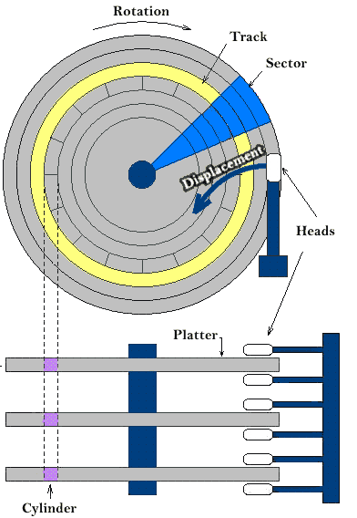
A partition is just a slice of the hard disk. Some operating systems are installing everything to one partition, while other such as Linux normally have several partitions on one hard disk. Using more than one partition makes sense because it makes it easier to distinguish between the different types of data. A sector is a unit in which partitions are measured. Example => partition starting at 1 sector, ending in 26. “Blue” partition. Exercises: 1. Create a file in your home directory. 2. List it’s permissions. 4. Do you think it’s safe to let the root user to log in inside a server from remote ( SSH ) ?
Understanding MBR and GPT partitions

Slide 2
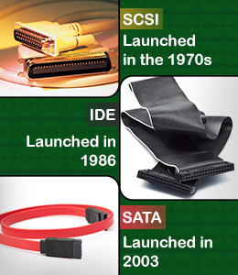
How devices are represented in Linux ? In Linux, for the most part you have ‘Character’ and ‘Block’ devices. Exercises: 1. ls –l tty0 2. ls –l /dev/sda All devices in Linux are under /dev directory or file system. Block devices can be cached in memory and read back from cache, writes can be buffered. Character devices writing/reading is an immediate action. An interface is a channel capable of transferring data in parallel mode – transmitting multiple bits simultaneously. The most common interfaces are SCSI and SATA. Linux started representing the device with the SCSI/IDE interfaces and continued with just SCSI, no matter that the hard disk might use SATA. IDEs are no longer used.

Slide 3
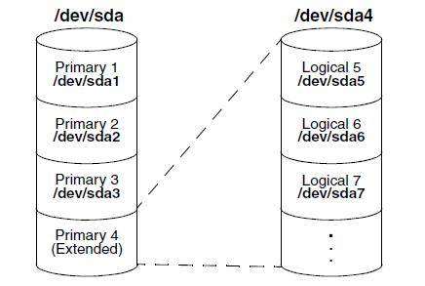
When the personal computer was invented in early 1982s, a system was needed to defines hard disk layout. It became known as Master Boot Record(MBR). It is stored on the first sector and represents how the hard disk is partitioned and it also loads the boot loader. The limitation of MBR is that only 4 partitions could be created. A workaround is to create an extended partition, within it, a number of logical partitions.
You could manipulate the partition table on MRB with ‘fdisk’
Exercises:
Add a new disk on your VM.
Create 3 main partition and one extended.
On the extended partition, create two more partitions.
4. Google what does a ‘swap’ partition do, create one swap partition.

Slide 4
The need for GPT Partitions
Current computer hard drives have become too big to be addressed by the MBR partitions. That is why a new partitioning scheme was needed. This scheme is the GUID Partition Table(GPT). On computers using the new Unified Extensible Firmware Interface (UEFI) as a replacement for the old BIOS, GPT partitions are the only way to address disks.
In GPT, up to 128 partitions can be created. A backup copy of the GUID partition table is created by default at the end of the disk, which eliminates the single point of failure that exists in MBR. The 2TB limit no longer exists.

Slide 5
Let’s do this together! 1. (while true; do echo “I smell Linux power”; sleep 1; done) 2. Are u able to use the shell ? Ctrl + Z; 3. Run jobs, anything familiar there ? 4. Run fg 1, what do you think happened ? 5. Run the first command in the background, but add –n to echo and change it to Unix power. Tasks on Linux are started as processes. Once process can start several worker threads. As a Linux admin, you cannot manage individual threads, it is the programmer of the multithreaded application that has to define how threads relate to one another.

Slide 6
Managing Parent Child Relations When a process is started from the shell, it becomes a child process of that shell. The parent is needed to manage the child. For that reason, all processes started from a shell are terminated when that shell is stopped.
Sending to a process a signal.
You could inform a process that you are expecting a behavior out of it. Most often it’s the ‘kill’ command to terminate the process either gently(by releasing all resources that it covers) or by a quick murder no matter what.
Signal number | Short name | Definition | Purpose
1 | HUP | Hangup | Used to report termination of the controlling process of a terminal.
9 | KILL | Kill, unblockable | Causes program termination. Cannot be ignored, always fatal.
15 | TERM | Terminate | This is the default kill signal, it asks politely the program to terminate.

Slide 7
Exercises: 1. List your processes and try to gently kill a process that is not needed. 2. See the result, run the killed process again and try to brutally kill it. 3. Try to kill the first systemd process, what happens ? 4. Run pstree to see a tree representation of all running processes. killall => send a signal to one or more processes matching selection criteria. pkill => uses advanced search criteria. Examples: pkill –SIGKILL –u bob => kills all processes owned by bob. When Linux processes are started, they are started with a specific priority. By default, all regular processes are equal and started with the same priority (20). In some cases, it is useful to change the default priority that was assigned to the process when it was started. Use nice/renice.

Slide 8
Homework: 1. Explain in class what does ‘load average’ metric means. 2. Grep for ‘model name’ in ‘/proc/cpuinfo’, explain to your colleague sitting why you are searching in /proc 3. Start a process with ‘nice –n 5 dd if=/dev/zero of=/dev/null &’ 4. Find PID of the above process, and change it’s priority to 10.

